Slide 1
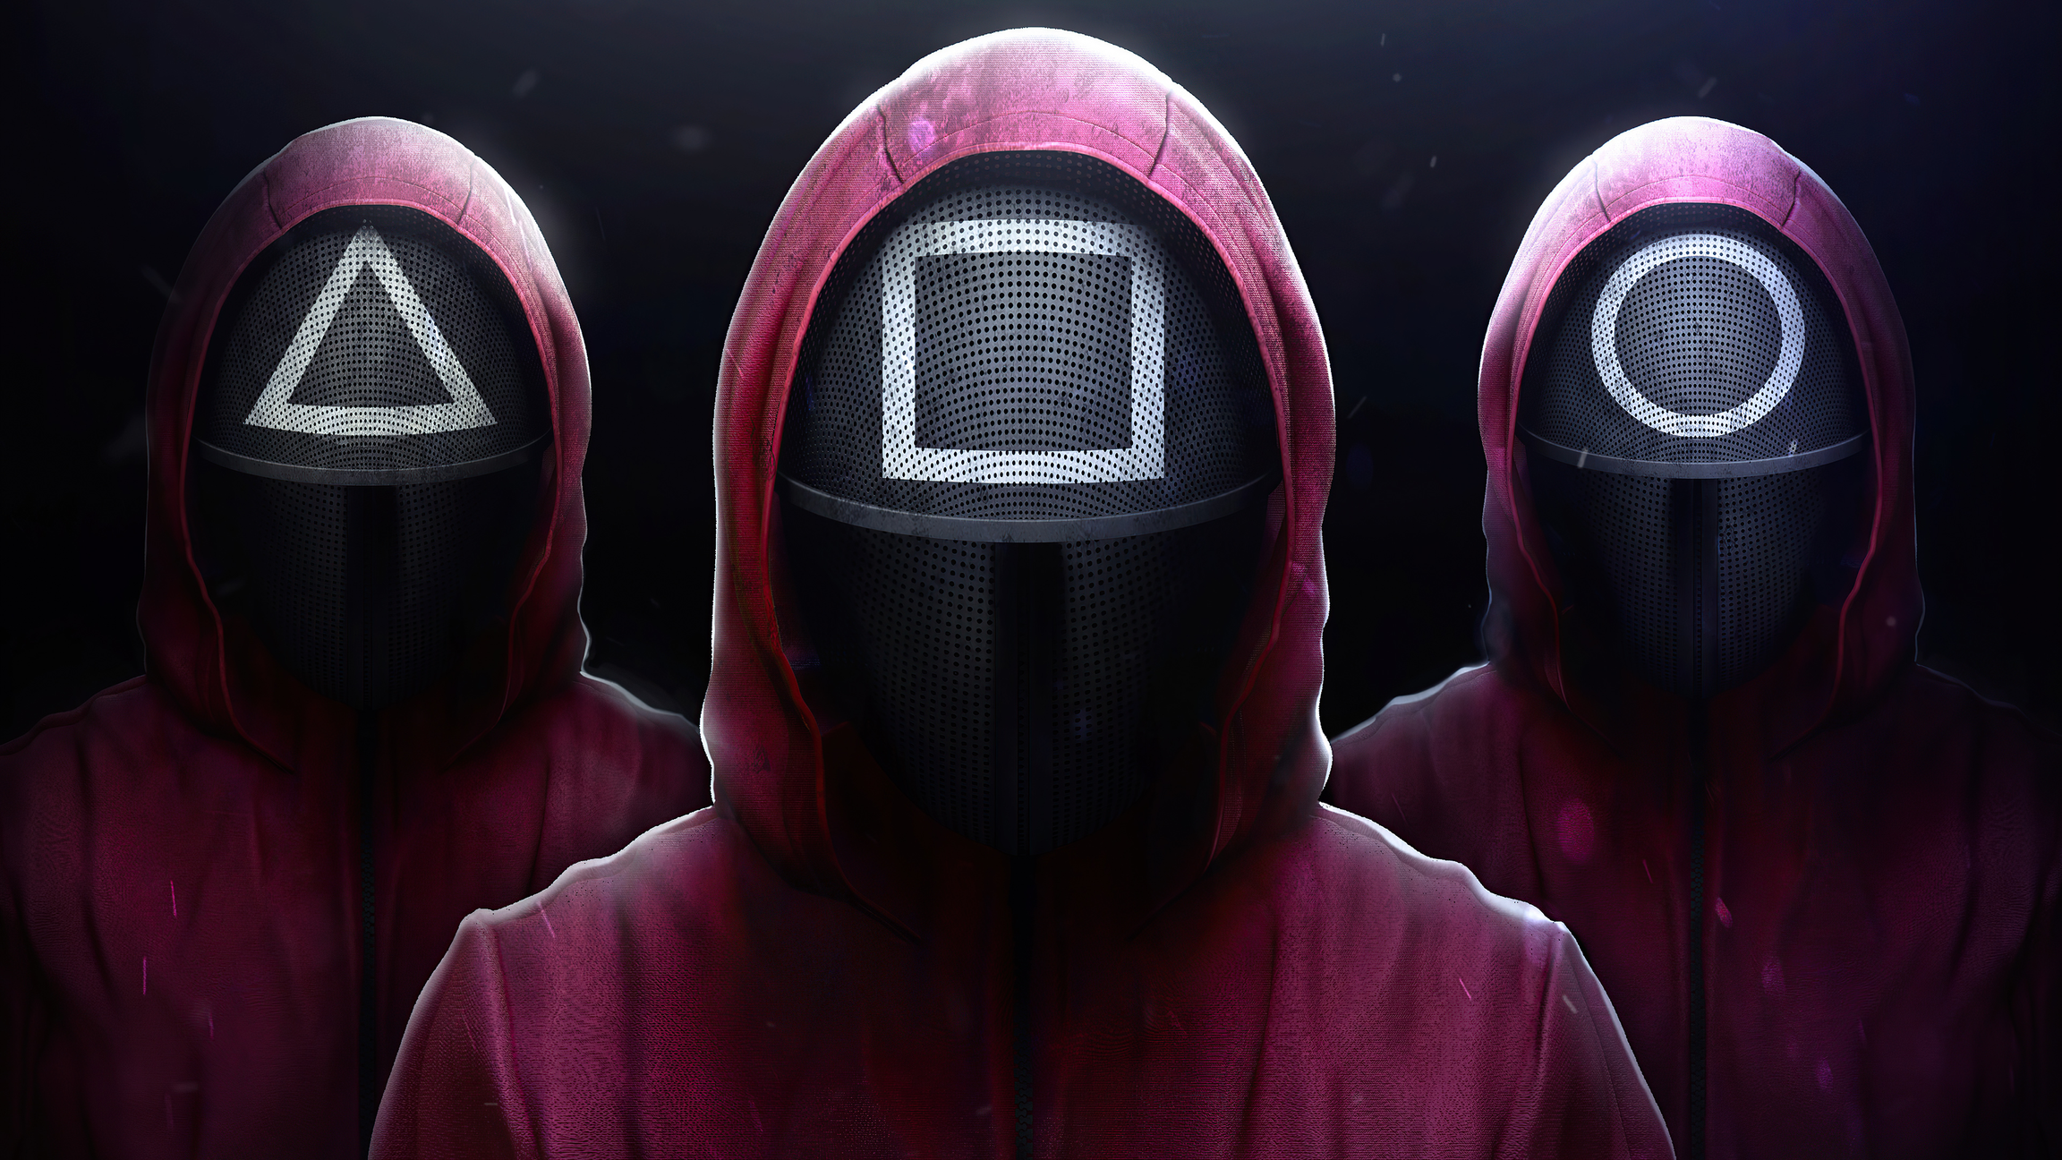
Red Light Green Light
SAMBIT SAHOO
22277

Slide 2



INTRODUCTION
02
The game “Red Light Green Light” detects player’s movements and tracks actions. Using real time object tracking and motion detection the game identifies whether an object moves during the red light or not. If detects motion during red light or game is not completed within stipulated timeline declares “Game Over” else declares “Winner”

Slide 3
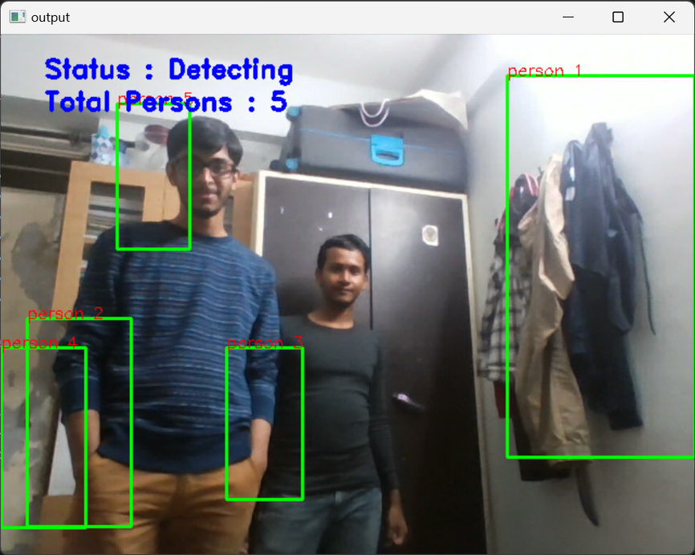
HUMAN DETECTION using HOGCV
03
Firstly used HOGCV for human detection and creating Bounding box around it.
WORKFLOW:
1. Image Preprocessing
2. Compute Gradients
3. Orientation Binning
4. Block Normalization
5. Feature Vector Creation
6. Classification
7. Sliding Window Detection

Slide 4
HUMAN DETECTION using HOGCV
04
But I observed, human detection is not performed well here.
Reasons:
Extracts handcrafted features, effective for simpler, well-defined tasks but struggles with complex scenarios, such as occlusion, varying scales, and lighting conditions.
Computationally expensive, especially when combined with sliding window techniques across multiple scales to detect humans at various sizes. This limits its real-time usability.
Prone to false positives and negatives due to its reliance on manually tuned features and limited ability to generalize across complex datasets.
uses INRIA dataset (~ 2473 images)

Slide 5
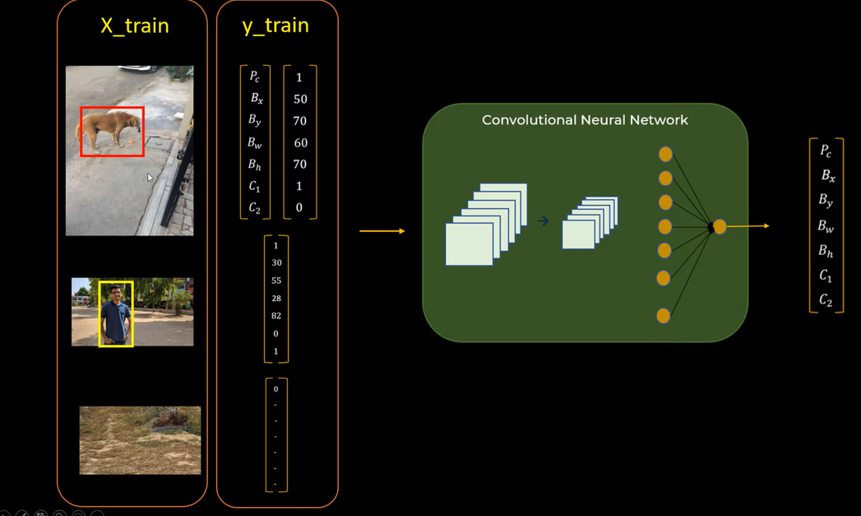
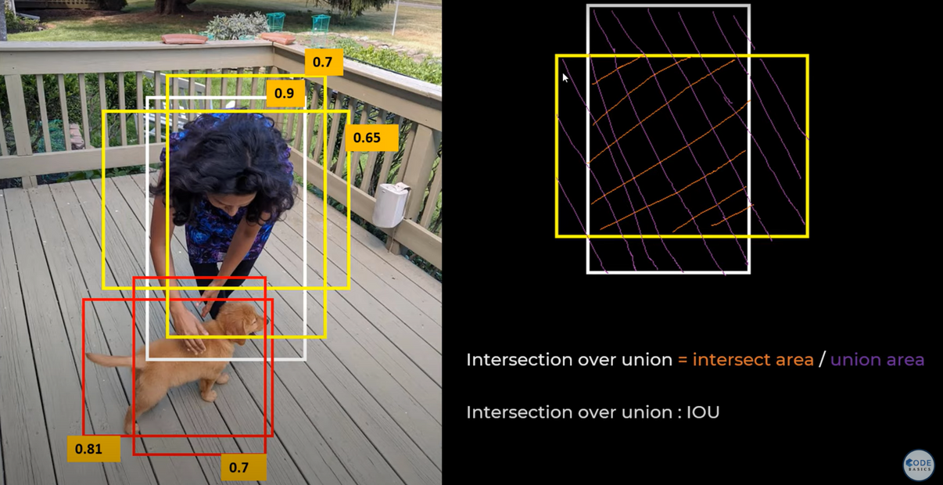
HUMAN DETECTION using YOLO v8
05
Used YOLO v8 for human detection and creating Bounding box around it.
It uses an efficient convolutional neural network (CNN) architecture for fast and accurate real-time detection of objects, including people. It consists-
Backbone: Uses a modified CNN architecture.
Neck: Uses a feature pyramid network (FPN) and path aggregation network (PAN) to aggregate information across multiple scales.
Head: The head of the model performs the task-specific outputs, which include detecting objects, classifying them (e.g., person, car, dog), and predicting the bounding boxes.

Slide 6
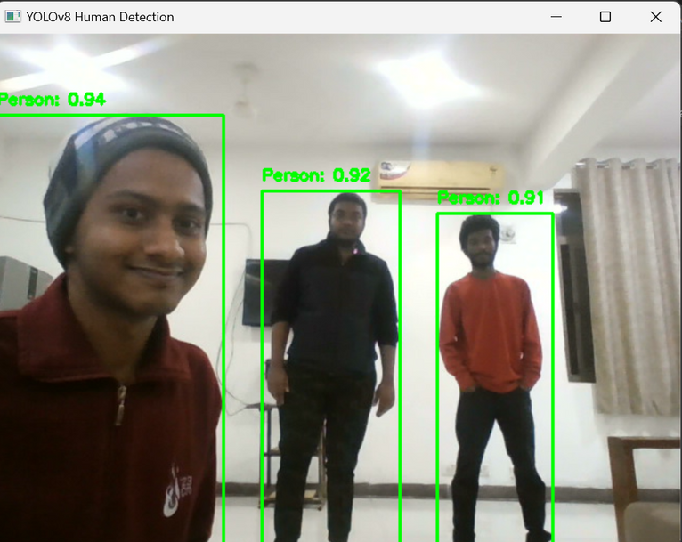
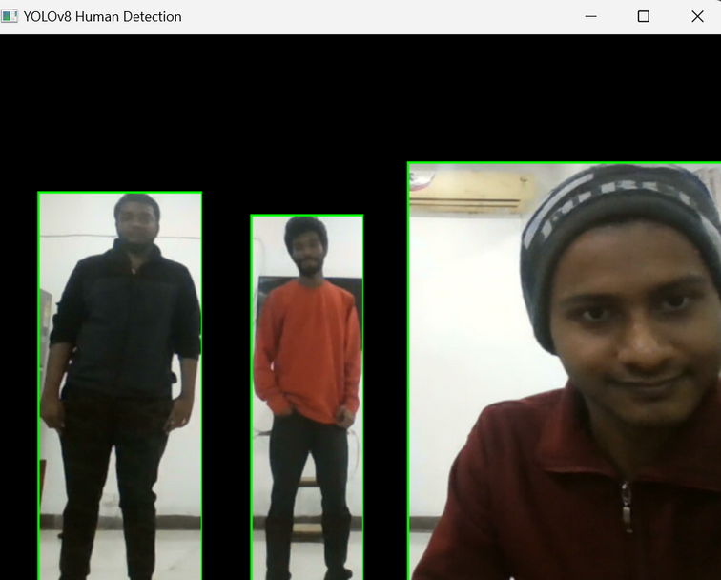
HUMAN DETECTION using YOLOv8
06
YOLOv8 outperforms Histogram of Oriented Gradients (HOGCV) in human detection tasks due to its deep learning-based architecture and modern advancements in computer vision.
single-stage detection pipeline significantly reducing computation time.
uses COCO dataset (over 330,000 images and 80 object categories.)

Slide 7
MOTION DETECTION
07
Compared consecutive frames from the webcam and looked for differences in pixel values.
Used Frame Differencing then applied threshold and eventually updated the frames.
Thresholded image dilated to ensure that small movements are also detected.
Found Contours in the dilated image.
If found then motion is detected.
DEMONSTRATION
Winner
Game over

